Slide 1

FloraAi: An Ai Powered Mobile Application For Intelligent Plant Care
Graduation Project
2025-2026
Supervised By
Dr. Hanaa Bayoumi
Eng. Ali Abdullah

Slide 2
Team Members
Ai
Backend
Flutter
Ahmed Abu Almakarem Youssef
2202812
Ahmed Hassan Mahmoud
2202813
Marwan Hamdy Mahmoud
2202836
Fayez Mohamed Fayez
2202744
Ahmed Maher Mohamed
2202801
Yousef Alaa Eldeen Abdelwahab
2202849
Aslam Khaled Abady
2202770
Ahmed Hosny Abdelmenem
2202846

Slide 3
Presentation Outline
01.
02.
03.
Introduction
Related works
Objectives
04.
05.
06.
Methodology
Conclusion
Future work

Slide 4
01.Introduction

Slide 5

01. Introduction
As indoor gardening gains popularity, many hobbyists struggle to diagnose plant illnesses because symptoms often look identical across different species. Most market solutions are limited to specific farm crops, leaving home gardeners without reliable support.
FloraAI solves this by focusing on the 'root cause' rather than the plant type. Our system detects the unique visual signatures of pathogens, enabling accurate classification of Fungi, Bacteria, Viruses, and Pests on any plant.
But we didn't stop at diagnosis. We also built a Personalized Care Scheduler that helps users manage their daily gardening tasks. This feature allow users to know watering and fertilizing reminders for each of their plants, ensuring they stay healthy and hydrated long before any disease appears

Slide 6
Why FloraAI Matters?
Indoor gardening is exploding, but people struggle to keep plants healthy
Global Trend:
The Loss Statistic:
The Gap:
Indoor plants market is surging globally, with the market projected to reach $26 Billion by 2030 (CAGR of 4.8%).
Source: Grand View Research, "Indoor Plants Market Size & Trends Analysis Report (2023-2030)."
Up to 40% of global crop yields are lost to pests and diseases annually (FAO estimate).
For home growers, disease is the #1 reason for giving up on gardening.
Source: Food and Agriculture Organization (FAO), "International Plant Protection Convention Estimates.
Millions of new "Plant Growers" lack agricultural expertise.
Need for a digital assistant to bridge the gap between passion and knowledge.
https://marketresearch.biz/report/indoor-plants-market/
https://www.fao.org/plant-health-2020/about/en/
Most plant apps focus on large-scale agriculture, not indoor gardeners

Slide 7
Problem Statement
Misdiagnosis of Plant Problems:
Symptoms of plant distress from fungi, bacteria often appear identical to non-experts. This leads to frequent and frustrating misdiagnosis.
Commercial Focus, Not Home Gardens:
Existing AI diagnostic tools focus on commercial crops (e.g., Tomato, Potato). These solutions critically fail to identify issues in common household and ornamental plants cherished by home growers
Accessibility & Latency Bottlenecks:
Unreliable Mobile Solutions: Many current apps require strong internet for cloud processing. This makes them useless in remote or low-connectivity areas, where urgent help is often needed.

Slide 8
02.Related work

Slide 9
Paper Name
Data set
Techniques and Algorithms
Accuracy
Limitation
Plant Leaf Disease Detection using MobileNetV2. (2025)
PlantVillage (54,305 images, 38 classes)
MobileNetV2 (CNN), Transfer Learning, Adam Optimizer, Data Augmentation.
94.32% (Validation Accuracy)
Class Imbalance Sensitivity: Performance drops significantly on uneven datasets (e.g., few diseased vs. many healthy images) compared to heavier models.
Doesnt implement a Treatment plan.
Attention-Fused Residual Lightweight MobileViT for Plant Leaf Disease Detection.(2025)
Plant Disease /Pant Doc Dataset
RTR-Lite-MobileViT (Hybrid CNN + ViT), Attention Fusion (SE, ECA, Triplet Attention).
99.92%
Performance Limitation: The model struggles with detecting subtle symptoms and differentiating between visually similar disease categories
AgroAId: A Mobile App System for Visual Classification of Plant Species and Diseases Using Deep Learning and TensorFlow Lite .(July 2022)
PlantVillage (Augmented, ~61k images)
EfficientNetB0 (Best Model), MobileNet, NasNetMobile, TensorFlow Lite (TFLite).
~99% (EfficientNetB0)
Fixed Taxonomy: The system is limited to the specific 39 [species-disease] classes it was trained on. It cannot identify unknown diseases or crops outside this set (the "Open World" problem).

Slide 10
03.Objectives

Slide 11

Main Objective:
To develop a comprehensive plant care and diagnostic application that serves as an advanced learning tool to accurately classify leaf conditions into five main categories: Fungal, Bacterial, Viral, Pests, or Healthy and to give users tips on how to care for their plant
Specific Objectives:
Model Development
Performance & Care
Balance accuracy and inference speed
Validate >90% and add care scheduler
Data Preparation
Mobile Optimization
Care Schedular
Train on general disease signs
Use TensorFlow Lite for offline use
helps users track routine maintenance tasks like watering and fertilizing.

Slide 12
04. Methodology

Slide 13
Ai Workflow
Data Collection
Model Selection
Evaluation
1
2
3
4
5
Preprocessing
Training

Slide 14
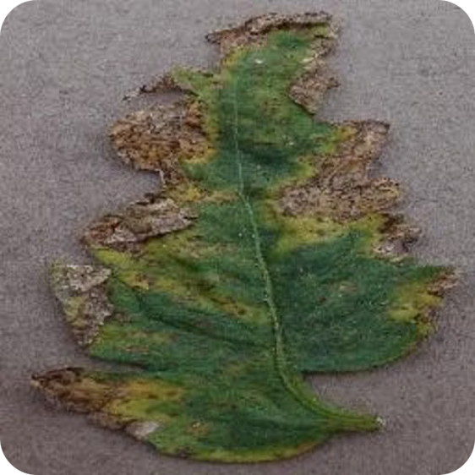
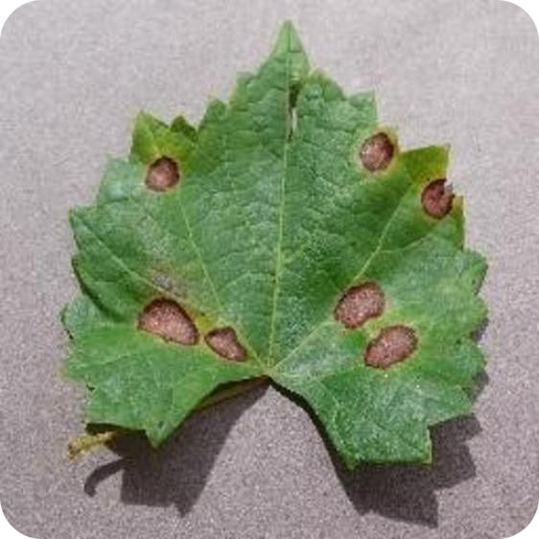
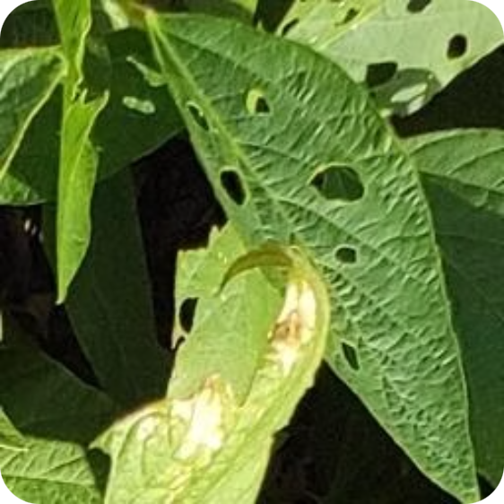
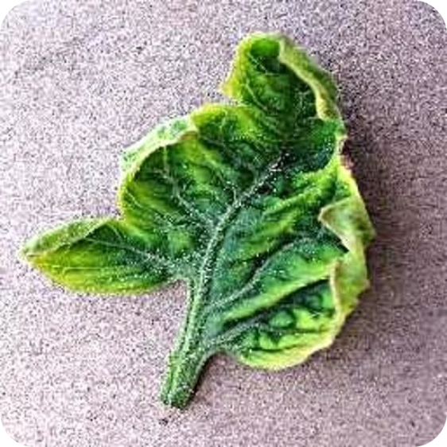
Dataset Structure
Philosophy: We moved away from "crop-centric" datasets (e.g., Tomato_Blight) to a pathogen-centric structure. This forces the model to learn the visual texture of the disease itself, not the plant.
Class Balance: The data is categorized into 5 universal, Balanced classes each has 8K images, in total 40K images :
Dataset: Plant Pathogen Dataset
https://www.kaggle.com/datasets/kanishk3813/pathogen-dataset
Bacteria
Fungi
Pests
Virus

Slide 15
Dataset Validation
Feature
PlantVillage (Traditional Standard)
Plant Pathogen (Our Approach)
Classification Logic
Crop-centric, labeled by plant species and disease type
Pathogen-centric, labeled by the disease-causing agent
Class Balance
Often imbalanced across crops and disease classes
Balanced universal classes with equal representation
Target Scope
Specific Crops (Agriculture Focus)
Universal/Ornamental (Home Gardening Focus)
Diversity
Limited variation within a crop-specific dataset
Broader visual diversity across pathogen categories
Total Size
~54,000 Images (38 Classes)
Varies by crop and disease distribution
40K images total, 8K per class
Generalization
Lower transferability to unseen crops
Stronger cross-crop generalization

Slide 16
Data Processing Pipeline
Augmentation Engine
To prevent the model from "memorizing" clean lab images, we applied aggressive random transformations during training:
Dataset split
Split into train (80%), validation (10%), test (10%) sets using DataFrame partitioning .
Rotation & Zoom
Horizontal Flips
Brightness Adjustments
1
2
3
4
Normalization
Pixel values were scaled to the [-1, 1] range (for MobileNetV2) to accelerate gradient descent convergence.
Input Shape:
All images were resized to 224x224 pixels to match the input requirements of standard pre-trained architectures

Slide 17

Algorithm Selection
Why Deep Learning (CNNs) instead of Machine Learning?
Automated Feature Extraction: CNNs learn image Features directly from raw pixels.
Robustness: Better handling of unstructured image data.
Why Use Transfer Learning Over Training from scratch?
We employed Transfer Learning, repurposing a pre-trained model for our specific task.
Layer Freezing: initial layers are "frozen" to preserve universal feature detection.
Key Benefits: Enables faster training and higher accuracy with limited data.

Slide 18
Our Applied Architectures
Architecture
Concept
Role in Project
Key Outcome / Decision
ResNet50
Deep residual model for strong feature extraction.
Baseline for high-accuracy comparison.
Most powerful, but heavier and slower for mobile use.
MobileNetV2
Lightweight model designed for efficient edge deployment.
Primary model for mobile inference.
Best fit for fast, offline-first mobile inference.
EfficientNet-B0
Balanced model using compound scaling for efficiency.
Benchmark for efficiency-performance tradeoff.
Efficient, but not enough faster than MobileNetV2 to replace it.

Slide 19
Training & Performance
ResNet-50
EfficientNetB0
MobileNetV2
Epochs
15
30
30
Training Acc.
98.7%
96.67%
95.4%
Training Loss
0.05
0.11
0.14
Validation Acc.
98.6%
96.6%
95.25%
Validation Loss
0.04
0.11
0.14

Slide 20
Final Model Selection
The Winner: MobileNetV2
While ResNet-50 achieved the highest accuracy (98.6%), we selected MobileNetV2 (95.25%) as the production engine for FloraAI.
Justification for Selection:
Reasoning Speed: MobileNetV2 offers faster reasoning times than the other models, which is critical for real-time user feedback.
Model Size: Its "Inverted Residual" architecture creates a lightweight model (under 15MB) suitable for mobile storage.
The Trade-off: The 3.3% drop in accuracy was deemed an acceptable trade-off for the ability to run offline and preserve the user's battery life.

Slide 21
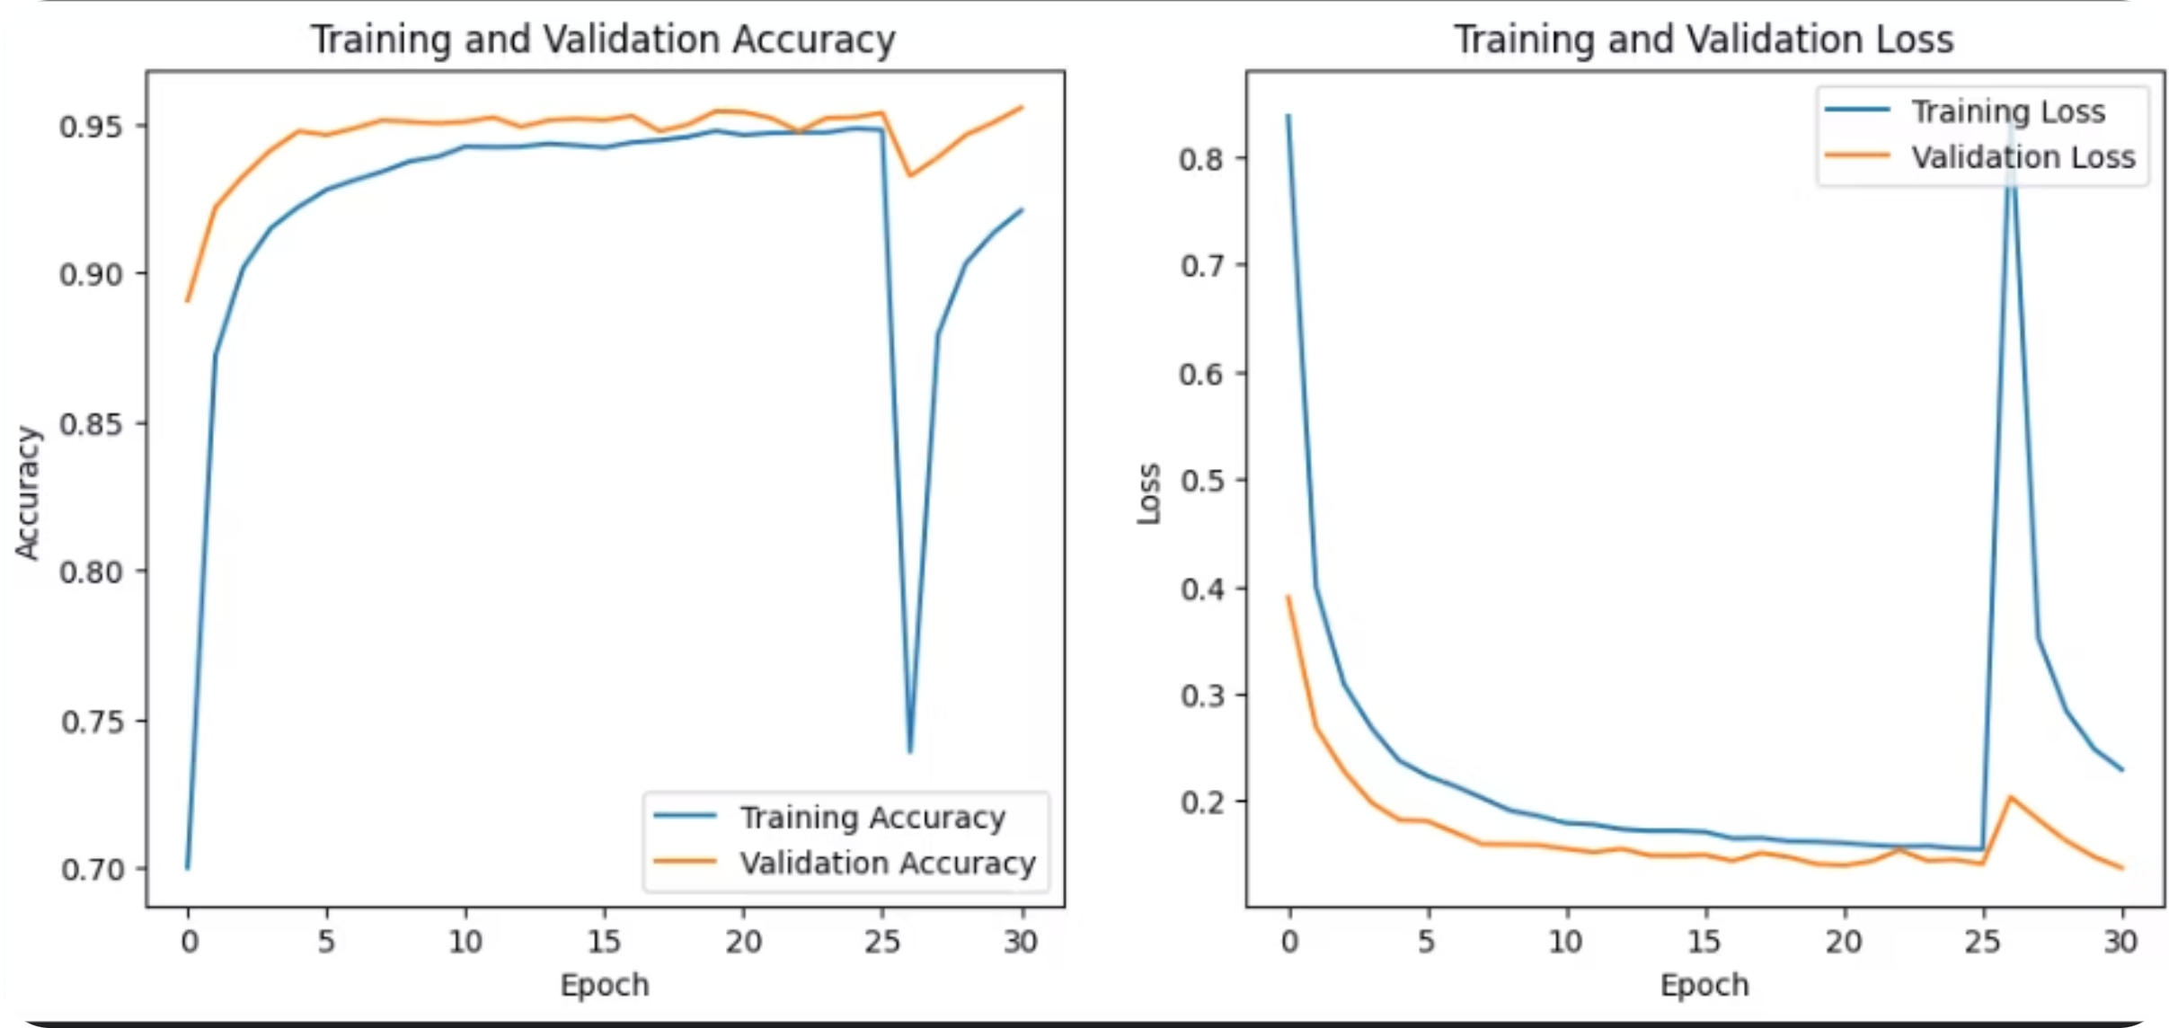
Model Performance
Accuracy: the model achieved 95.45% training Accuracy and 95.25% validation accuracy

Slide 22
Backend

Slide 23
Functional Requirements
Non-Functional Requirements
(What the system does)
(Performance & Quality)
Image Classification: The system must capture an image and classify it into one of five categories: Fungi, Bacteria, Virus, Pests, or Healthy.
Care Scheduling: The system shall give users reminders for watering and fertilization frequencies for each added plant.
Offline Inference: The system must perform disease diagnosis directly on the mobile device using TensorFlow Lite without requiring an internet connection.
User Account Management: The system must handle user authentication and profile management via the backend.
Data Synchronization: The system must sync user data and diagnosis history to the cloud when an internet connection is available.
Accuracy: The system aims for a validation accuracy above 90% on diverse leaf images.
Latency (Speed): Diagnosis should be instant , and API response times for the backend must be under 200ms.
Model Efficiency: The mobile model must be lightweight (under 15MB) to save space and battery.
Reliability: The backend system must maintain an Internal Server Error rate below 1%.
Scalability: The system uses a client-server architecture that separates the frontend from the backend to handle a growing user base.

Slide 24
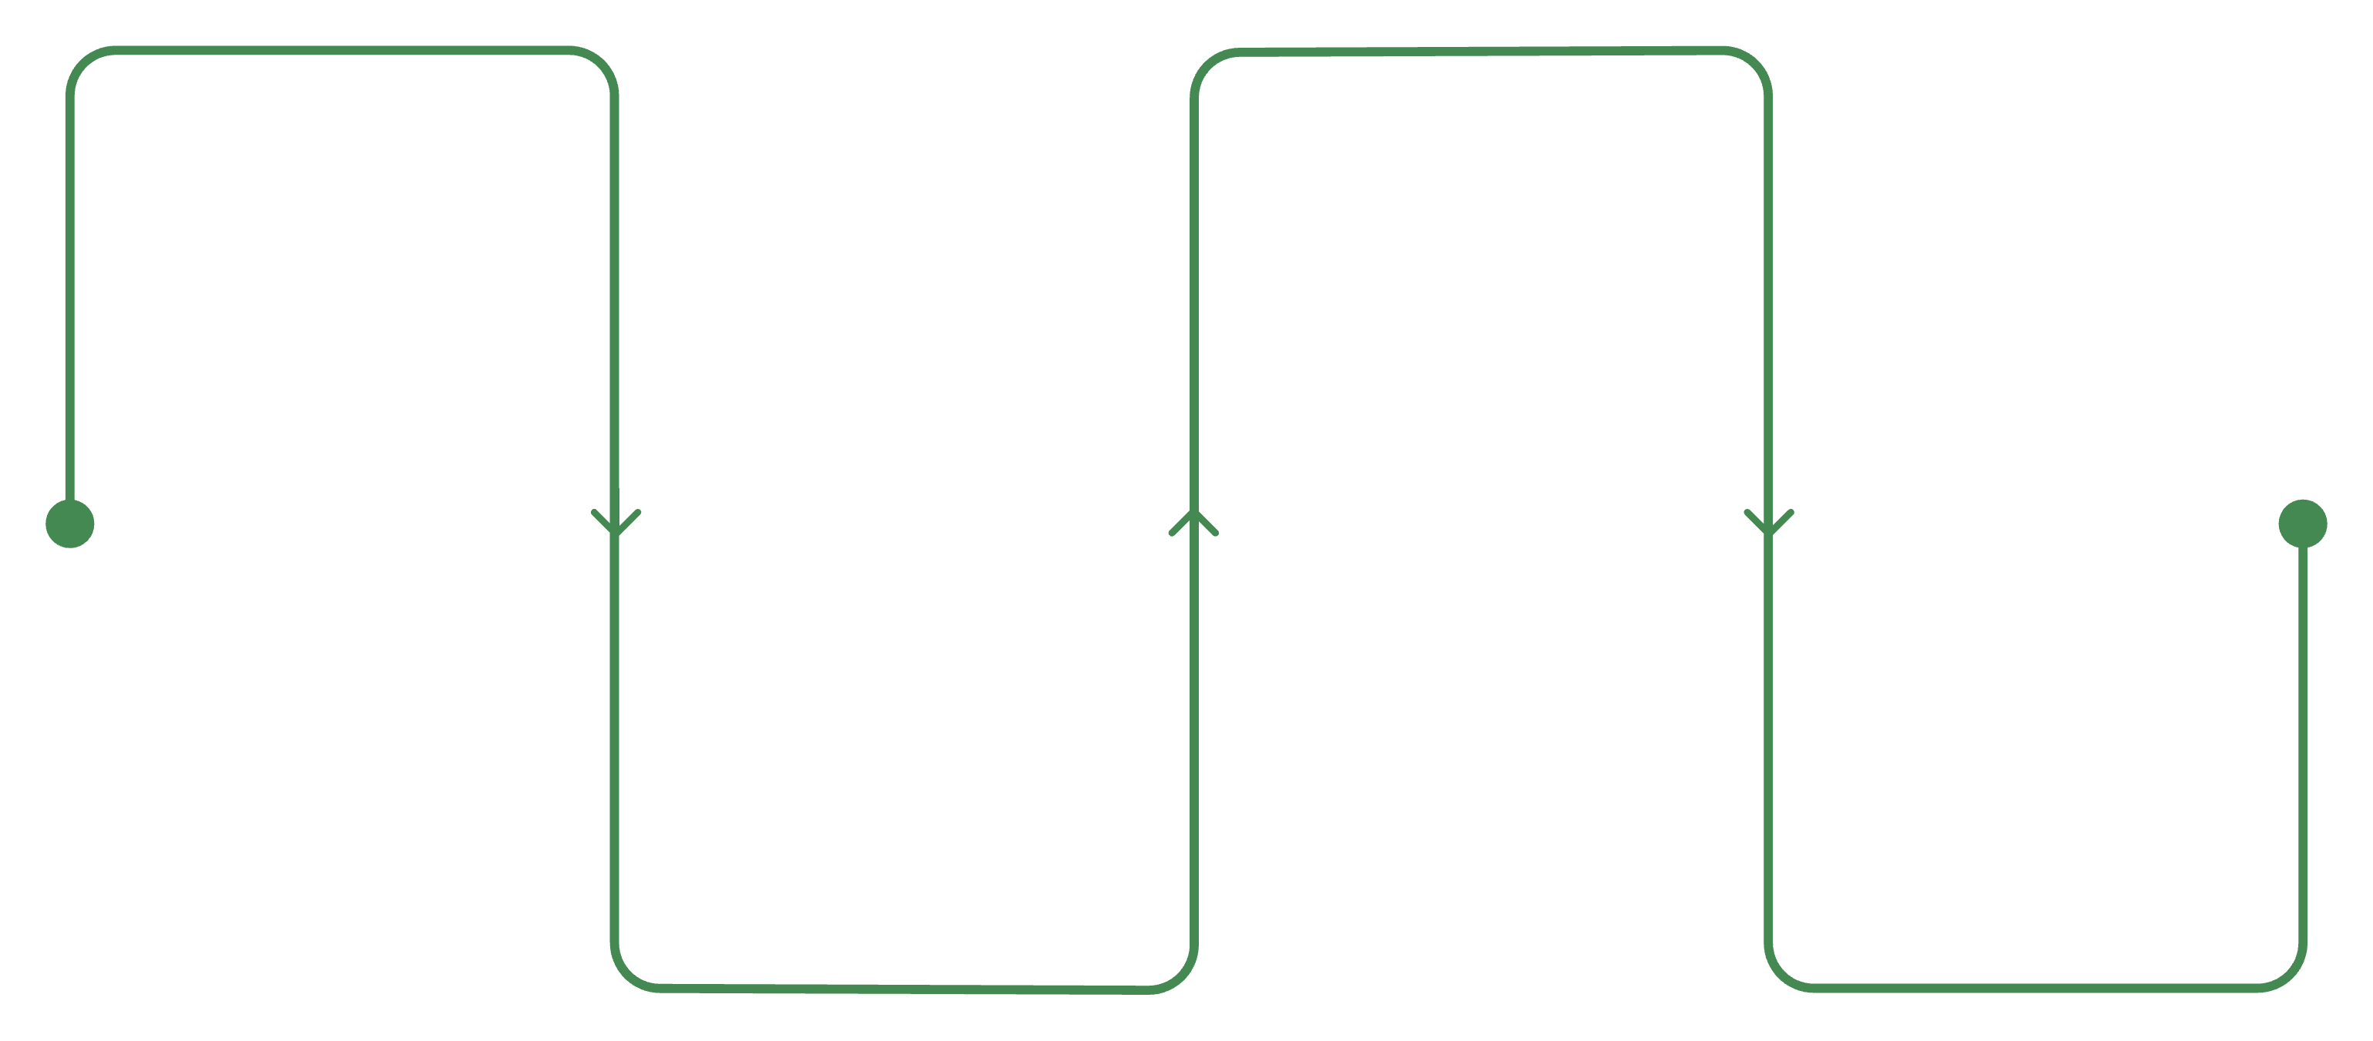
Back-End Roadmap
Phase 1
Phase 3 Deployment
Logic
Core .NET API & Domain Modeling
Postgres Migration & Railway Launch
Phase 2 Intelligence
Phase 4
QA
Gemini AI Integration & Prompt Tuning
Unit Testing & Multi-Level Security

Slide 25
Backend Orchestration & AI Services
Intelligent Caching Strategy
ConditionsDictionary Table: Global knowledge base storing expensive LLM outputs
Cache Hit Rate: 85–90% after initial knowledge base population
Response Time Reduction: 3.5–5.0 seconds → <50 milliseconds
Cost Optimization: Proportional reduction in Gemini API calls as user base expands

Slide 26
Cloud Deployment & CI/CD Pipeline
Zero-Touch Deployment & Secrets Management
Railway Cloud Hosting
Fully managed container orchestration ensuring isolated environments and high availability.
Git-Driven CI/CD
Automated .NET 10 builds, testing, and Docker image assembly triggered instantly upon git push.
Environment Protection
Centralized injection of cryptographic keys (Pepper) and API credentials to completely eliminate local codebase leakages

Slide 27

Persistent Strategy: PostgreSQL Shift
Optimization through Cloud-Native Migration
Memory Efficiency
JSONB Support
Self-Healing Migrations

Slide 28
Security & Defense-in-Depth
Multi-Layered Protection
Cryptographic Hardening: BCrypt + Password Pepper environment isolation.
Exploit Mitigation: LINQ parameterization blocking all SQL Injection attempts.
Zero-Leak Middleware: Global interception masking internal stack traces.

Slide 29
Governed AI Core: Gemini Integration
Prompt Engineering & Strict Contract Parsing
Brand Neutrality Guardrail
System prompt explicitly restricts commercial brands, extracting only generic Active Ingredients like "Neem Oil".
Dual-Structured Parsing
Separates the AI response into two streams:
Treatment: Natural Arabic storytelling narrative for high-quality UX.
Care Advice: Rigid JSON parsed strictly into a validated C# DTO (Watering, Soil, Light)

Slide 30






Hybrid AI Orchestrator
The backend bridges lightweight edge computing (Flutter client's MobileNetV2) with cloud intelligence
(Google Gemini 2.5 Flash API):
1. Receives TFLite classification
2. Checks ConditionsDictionary cache
3. Cache Hit
Returns cached treatment instantly (<50ms)
from mobile client
for previously generated advice
4. Cache Miss
5. Persists response
6. Returns structured JSON
Queries Gemini 2.5 Flash API for narrative treatment plan
to ConditionsDictionary for future queries
to mobile client for display

Slide 31

Resilient Mobile Experience
RAM Cache Hit
Utilizing a 10-item LRU policy for 0ms UI rendering latency of recent scans.
SQLite Persistence
Offline request queueing allowing users to diagnose plants in disconnected nurseries.
Sync Policy
Background workers push GUIDs and timestamps

Slide 32
Testing Tech Stack
XUNIT
MOQ
FLUENTASSERTIONS
COVERLET
Multi -Layered Testing & Security Resilience
Testing Layers
Unit Testing
Security & Fuzzing
Integration (E2E) Testing
Exception Handling

Slide 33
App Demo

Slide 34

App Demo

Slide 35
06.Conclusion

Slide 36
Conclusion
FloraAI achieves 95.25% validation accuracy using the optimized MobileNetV2 architecture, delivering professional-grade plant disease diagnosis on consumer mobile hardware.
FloraAI operates as a tool for precision horticulture, translating complex pathological patterns into actionable advice for non-specialist users. The system democratizes access to expert-level plant care guidance regardless of technical expertise or botanical knowledge.
Privacy & Efficiency
Edge AI Approach: Processes images locally, preserving user privacy by eliminating cloud metadata exposure
Hybrid Cloud Model: Provides deep, narrative care instructions in Arabic
Offline-First Architecture: Core diagnostic functionality remains fully operational without internet connectivity
Cost-Neutral Scaling: One-time model optimization investment replaces recurring API billing

Slide 37
07. Future Work

Slide 38

Future Work
1
2
2
Climate & Weather Integration
Species Identification Head
Incorporate real-time local weather APIs (temperature, humidity, UV )
Dynamically adjust watering schedules and predict climate-driven disease risks
Multi-task model to detect host plant + pathogen simultaneously
Enables species-specific diagnostic probabilities
3
Treatment Protocol Library
Step-by-step organic/chemical care guides with image references
Integrated treatment planning beyond diagnosis

Slide 39
Thank You
For Listening

